Slide 1



New Zealand Motor Theft
View in Power BI
Last data refresh:
19/08/2024 13:23:20 UTC
Downloaded at:
20/08/2024 20:09:01 UTC

Slide 2
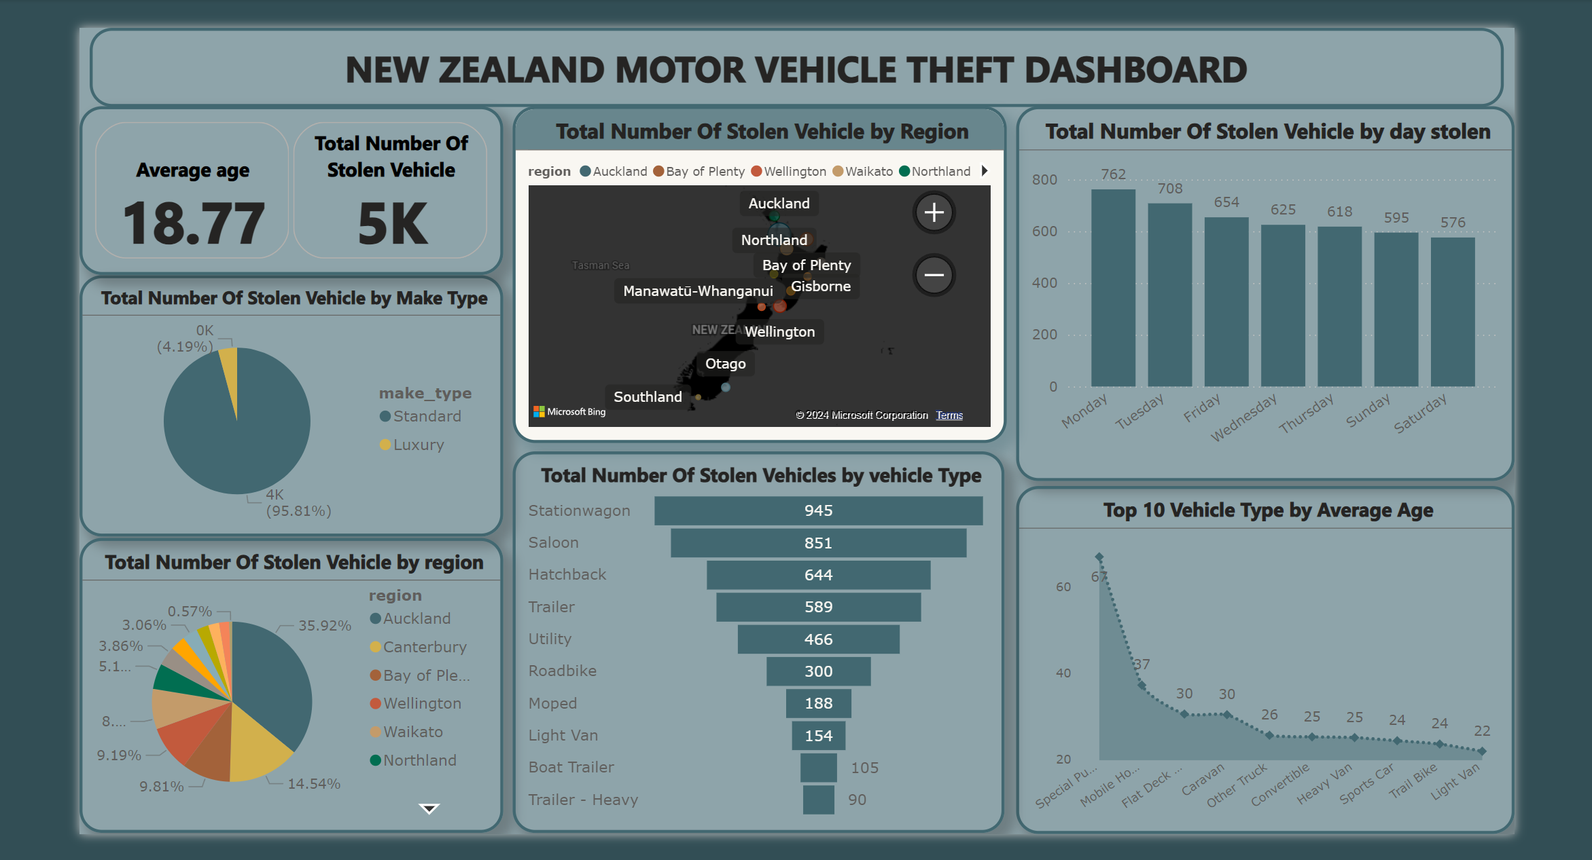
Dashboard
Notes:
columnChart
No alt text provided
Total Number Of Stolen Vehicle by Make Type
No alt text provided
pieChart
No alt text provided
cardVisual
No alt text provided
Top 10 Vehicle Type by Average Age
No alt text provided
textbox
No alt text provided
map
No alt text provided
Total Number Of Stolen Vehicles by vehicle Type
No alt text provided

Slide 3
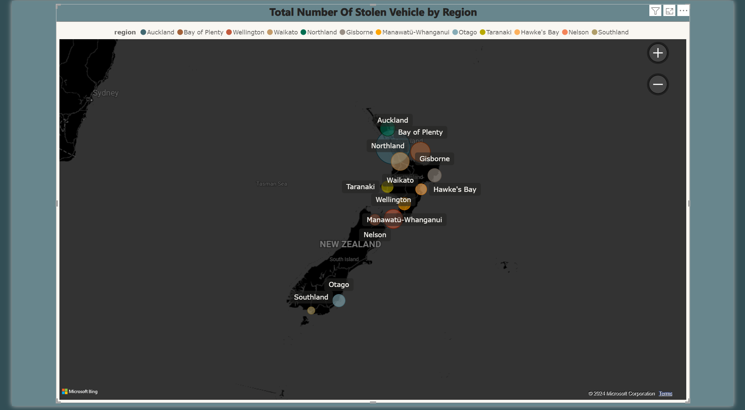
Total Number Of Stolen Vehicle by Region
Notes:
map
No alt text provided

Slide 4
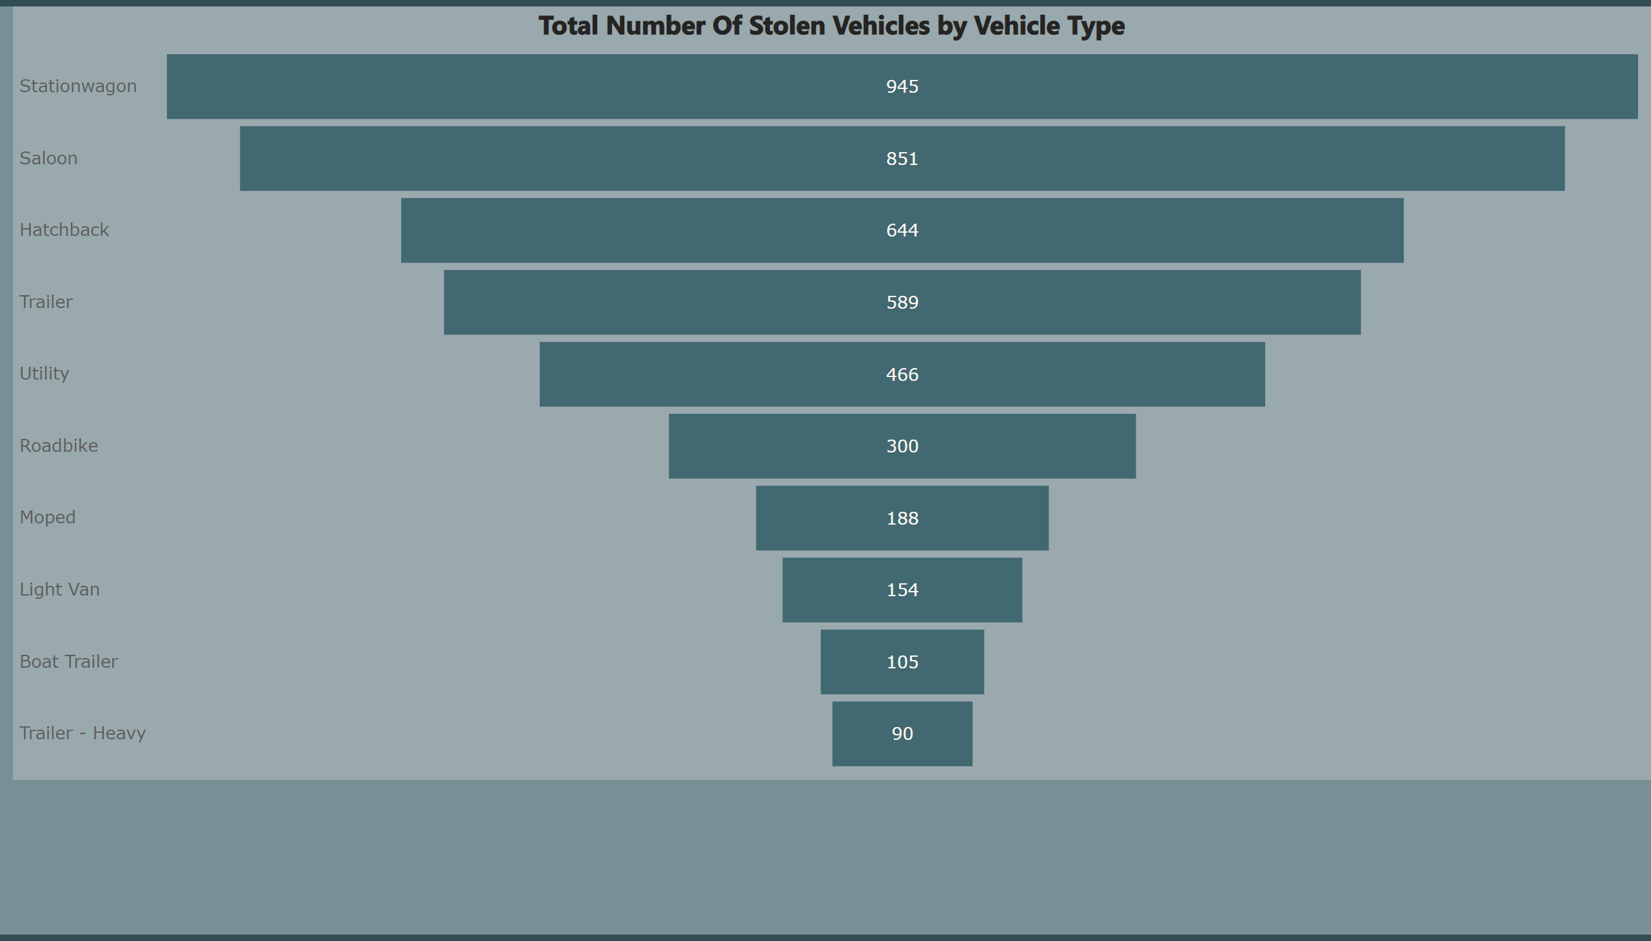
Total Number Of Stolen Vehicle by Vehicle Type
Notes:
Total Number Of Stolen Vehicles by Vehicle Type
No alt text provided

Slide 5
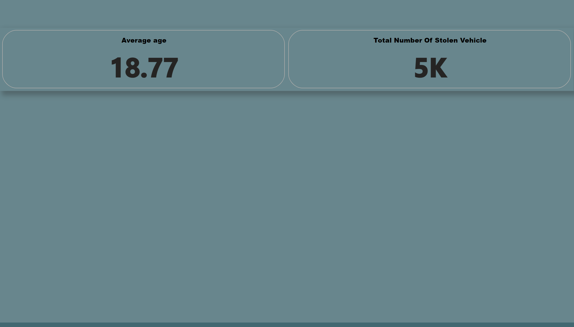
Cards
Notes:
cardVisual
No alt text provided

Slide 6
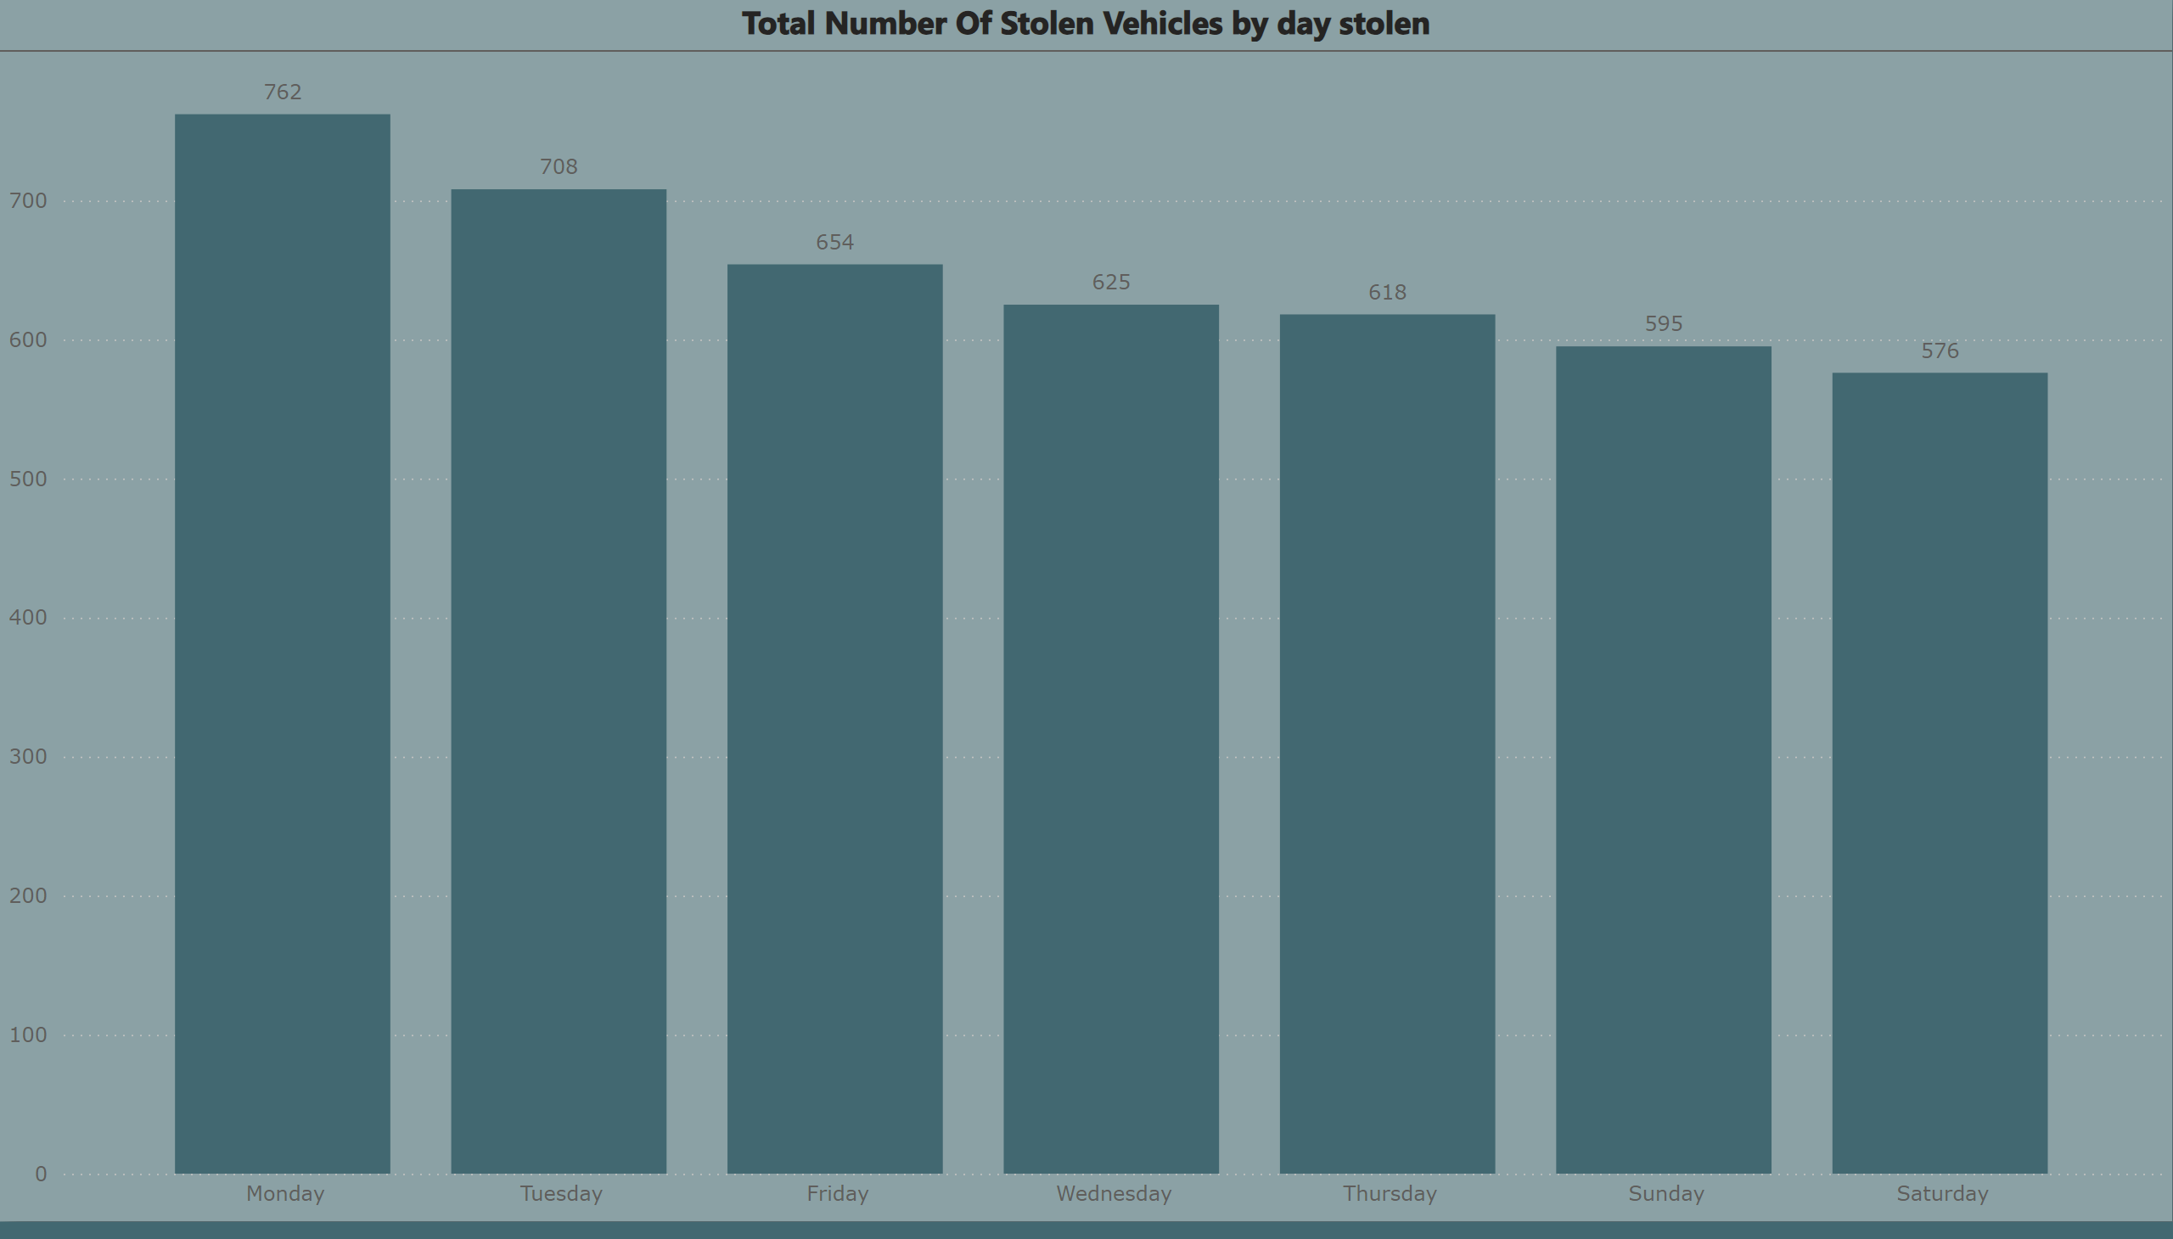
Total Number Of Stolen Vehicles by day stolen
Notes:
Total Number Of Stolen Vehicles by day stolen
No alt text provided

Slide 7
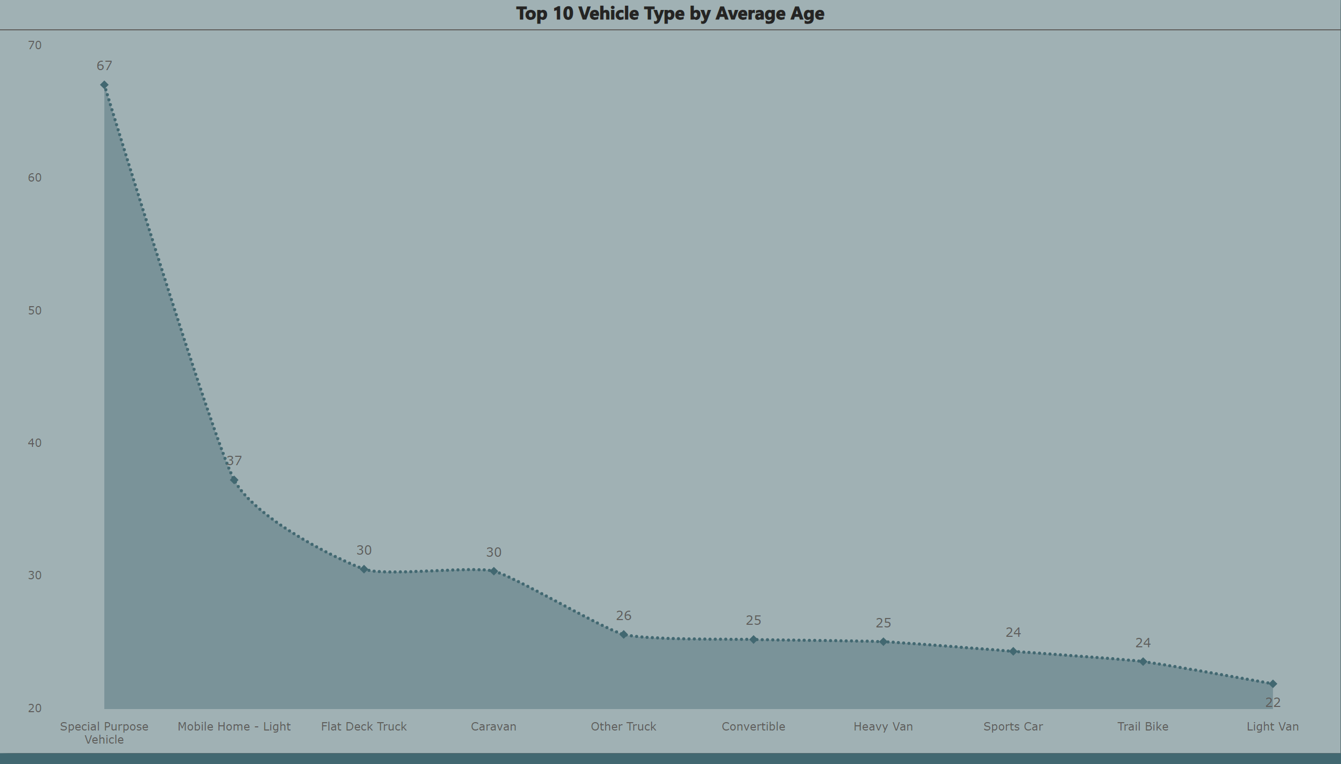
Top 10 Vehicle Type by Average Age
Notes:
Top 10 Vehicle Type by Average Age
No alt text provided

Slide 8
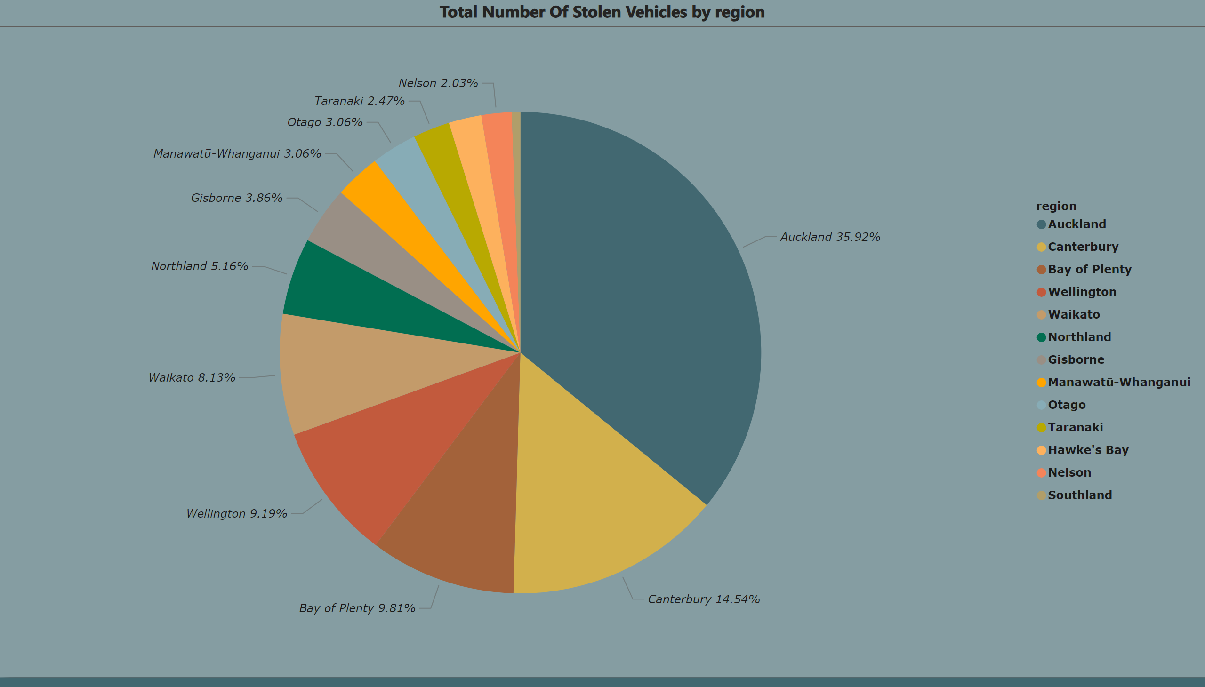
Total Number Of Stolen Vehicle by region
Notes:
Total Number Of Stolen Vehicles by region
No alt text provided

Slide 9
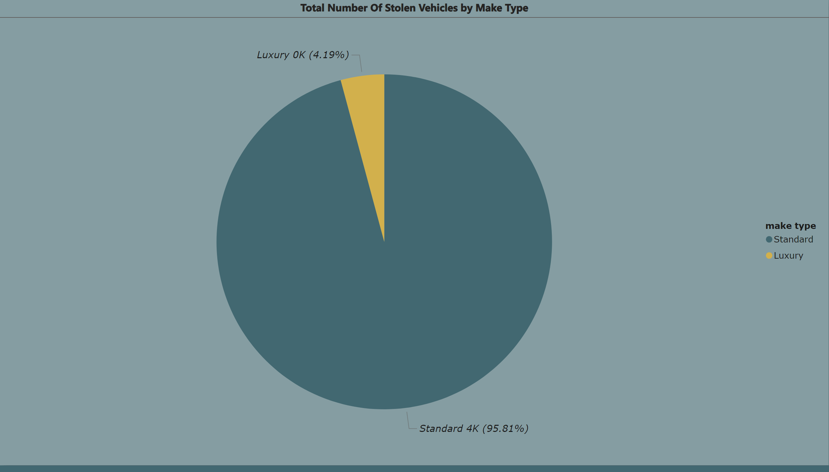
Total Number Of Stolen Vehicle by Make Type
Notes:
Total Number Of Stolen Vehicles by Make Type
No alt text provided

